Slide 1

Password Manager
Prepared By: Manan Hathi(19CE040)
Rushang Gandhi(19CE026)
Gosai Vatsal(19CE034)
Guided By: Arpita Shah

Slide 2
Introduction
Password Manager:- Password self-service reset and helpdesk management
Password Manager provides a simple, secure, self-service solution that allows and users to reset forgotten passwords and unlock their accounts.

Slide 3

Overview
Security:- Password manager is installed on hardened servers. All sensitive data is encrypted in storage and transit. Strong authentication and access controls protect business processers.
Scalability:- Multiple Password Manager servers can be installed, using a built-in data replication facility. Workload can be distributed using any load balancing technology. The end result is a multi master, distributed architecture that is very easy to setup, as replication is handled at the application layer.

Slide 4

Performance:- Password Manager uses a normalized, relational and indexed database back end. All access to the database is via stored procedures, which help to minimize communication overhead between the application and database. All Password Manager code is native code, which provides a performance advantage as compared to Java or .NET
Password manager is easy to set up and requires minimal administration.
Password manager connects to most target system using their native APIs and protocols and thus requires no software to be installed locally on those system.

Slide 5

Password manager can look up and update user profile data in an existing system, including HR database, directories and meta-directories.
Password manager can send e-mails to users asking them to register or to notify them events impacting their profiles. Over events can trigger e-mail notification.

Slide 6
Development Environment
Software Requirements : 1) Android (any version above 6)
2) Windows (any version above 7)
3) Google Chrome (any version above 89.0.0000.0)
Hardware requirements : PC / Laptop / Smartphone , Wi-Fi connection
Tools and Technologies : 1) PyCharm / Visual Studio Code
2) Windows (any version above 7.0) / MAC / OS
3) Python (any version above 3.0) 4) dJango
5) MySQL
Languages : 1) HTML
2) CSS
3) JAVASCRIPT

Slide 7
Project objective
Improve service to users:- This is due to fewer passwords to remember, a simple password change mechanism and faster resolution of password and intruder lockout problems.
Strong authentication:- This is due to strong and more consistent password policy enforcement, more strong authentication of users who forgot their password and enforced password expiry across all system.

Slide 8
Major Features/Functionality
• By default, Password Manager uses built-in certificates to encrypt traffic between Password Manager Web sites and Password Manager Service.
If the Web sites and the Password Manager Service are installed on different computers, it is recommended to replace these certificates with new ones.

Slide 9
Multiple instances of Password manager
A realm is a group of Password Manager Service instances sharing all settings and having the same set of Management Policies.
Several Password Manager instances sharing common configuration are referred to as a realm.
Password Manager realms provide for enhanced availability and fault tolerance.

Slide 10
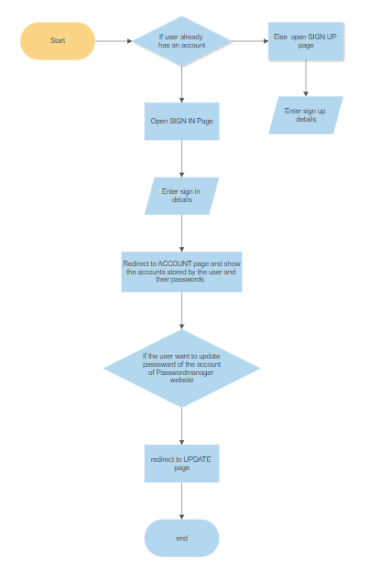
Flowchart

Slide 11
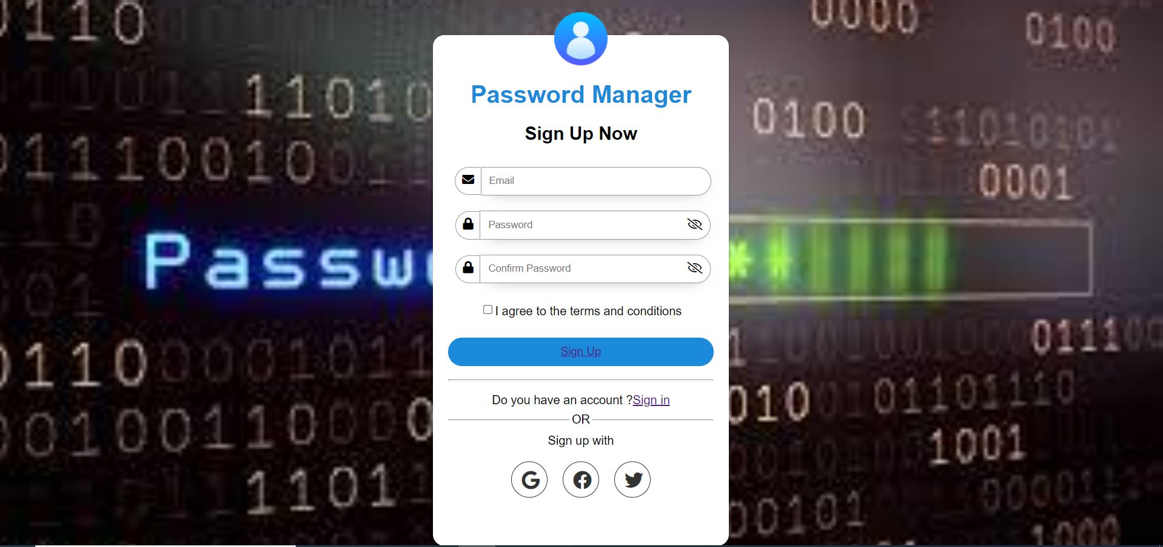
Design – SIGNUP Page

Slide 12
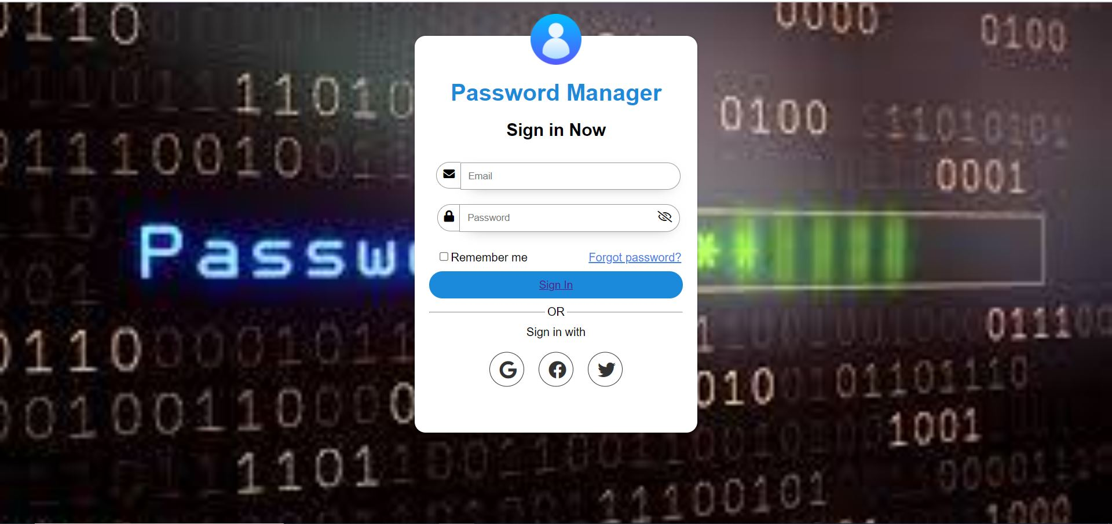
Design – SIGNIN Page

Slide 13
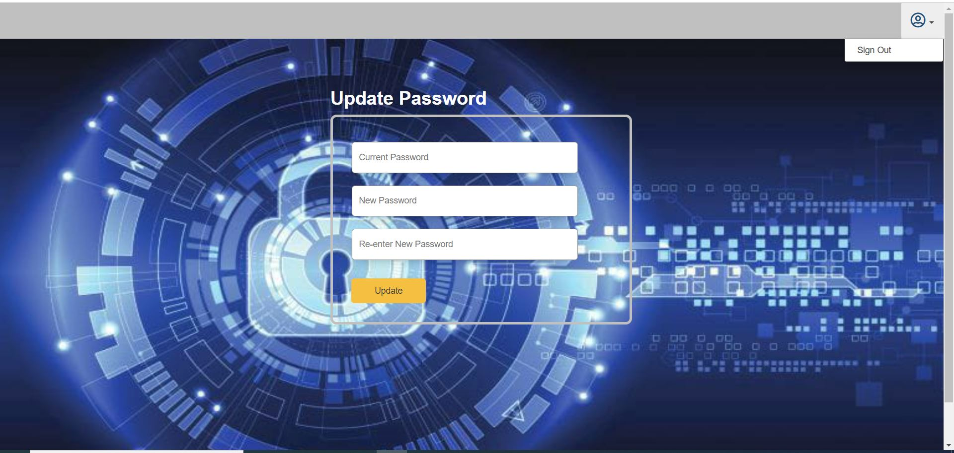
Design - UPDATE Page

Slide 14
References
Web Reference Links
https://youtu.be/ZsJRXS_vrwo
https://youtube.com/playlist?list=PLdBwVRHjcI__NWxctXUSLz1Gg2Mb-B-O-
https://docs.djangoproject.com/en/3.1/intro/tutorial01/
https://youtu.be/NomcZddqBfs
https://youtu.be/Ht3v1aXXf6s
https://youtu.be/g60QghtJmjY
https://youtu.be/8LEWb-eF8TE
https://medium.com/analytics-vidhya/connecting-python-to-mysql-8330f186c2d
Reference Books
Fundamental Concepts of Web Development by Roxane Anquetil

Slide 15
☺ THANK YOU.☺

